Slide 1


Slide 2

#LifeKoKaroLift
SGC Coaching Session 38:
Lexical Processing Context Setting Session Agenda
Session By: Mahendra

Slide 3
Agenda: Lexical Processing Context Setting Session Agenda
Overall Structure of the Course (20 mins)
Introduction to Text Preprocessing (30 mins)
Text cleaning using Regex Patterns - (25 mins)
Doubt resolution - (25 mins)

Slide 4
Introduction
Natural language processing (NLP) is the ability of a computer program to understand human language as it is spoken and written -- referred to as natural language. It is a component of artificial intelligence
NLP enables computers to understand natural language as humans do. Whether the language is spoken or written, natural language processing uses artificial intelligence to take real-world input, process it, and make sense of it in a way a computer can understand

Slide 5
How does natural language processing work?
Breaking down the elemental pieces of language
Natural language processing includes many different techniques for interpreting human language, ranging from statistical and machine learning methods to rules-based and algorithmic approaches. We need a broad array of approaches because the text- and voice-based data varies widely, as do the practical applications.
Basic NLP tasks include tokenization and parsing, lemmatization/stemming, part-of-speech tagging, language detection and identification of semantic relationships. If you ever diagramed sentences in grade school, you’ve done these tasks manually before.
In general terms, NLP tasks break down language into shorter, elemental pieces, try to understand relationships between the pieces and explore how the pieces work together to create meaning.

Slide 6
Applications.
These underlying tasks are often used in higher-level NLP capabilities, such as:
Content categorization. A linguistic-based document summary, including search and indexing, content alerts and duplication detection.
Topic discovery and modeling. Accurately capture the meaning and themes in text collections, and apply advanced analytics to text, like optimization and forecasting.
Contextual extraction. Automatically pull structured information from text-based sources.
Sentiment analysis. Identifying the mood or subjective opinions within large amounts of text, including average sentiment and opinion mining.
Speech-to-text and text-to-speech conversion. Transforming voice commands into written text, and vice versa.
Document summarization. Automatically generating synopses of large bodies of text.
Machine translation. Automatic translation of text or speech from one language to another.
Language Translation
Dialog Systems / Chatbots
Text Summarizers
Speech Recognition
Autocorrect

Slide 7
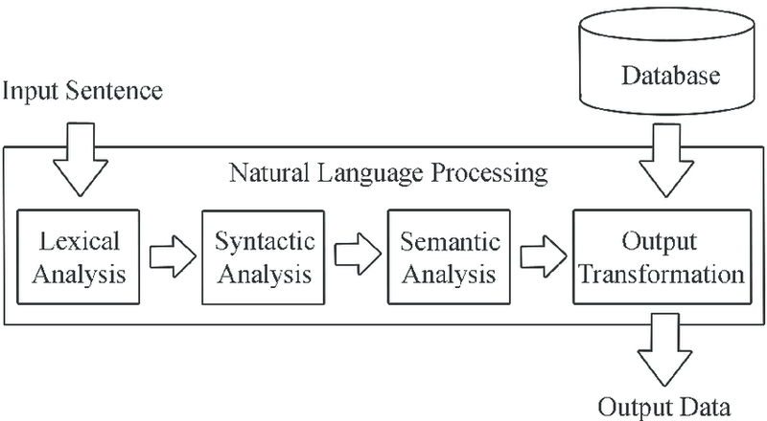
Parsing Text
NLP makes use of several algorithmic techniques to parse text. These include: lexical analysis and syntactic analysis.

Slide 8
Lexical Analysis
Lexical analysis is the process of trying to understand what words mean, intuit their context, and note the relationship of one word to others. It is often the entry point to many NLP data pipelines. It is used as the first step of a compiler, for example, and takes a source code file and breaks down the lines of code to a series of "tokens", removing any whitespace or comments. In other types of analysis, lexical analysis might preserve multiple words together as an "n-gram" (or a sequence of items).
After tokenization, the computer will proceed to look up words in a dictionary and attempt to extract their meanings. For a compiler, this would involve finding keywords and associating operations or variables with the tokens. In other contexts, such as a chat bot, the lookup may involve using a database to match intent. As noted above, there are often multiple meanings for a specific word, which means that the computer has to decide what meaning the word has in relation to the sentence in which it is used.

Slide 9
Syntactic Analysis
The syntax of the input string refers to the arrangement of words in a sentence so they grammatically make sense. NLP uses syntactic analysis to asses whether or not the natural language aligns with grammatical or other logical rules.
To apply these grammar rules, a collection of algorithms is utilized to describe words and derive meaning from them. Syntax techniques that are frequently used in NLP include the following:
Lemmatization / Stemming - reduces word complexity to simpler forms that have less variation. Lemmatization uses a dictionary to reduce the natural language to its root words. Stemming uses simple matching patterns to strip away suffixes such as 's' and 'ing'.
Parsing - This is the process of undergoing grammatical analysis of a given sentence. A common method is called Dependency Parsing, which assesses the relationships between words in a sentence.
Word Segmentation - This is the separation of continuous text into separate words. In English this is easy because all words are usually separated by spaces, but for some languages like Japanese and Chinese they do not mark spaces for words. This is when word segmentation becomes very useful

Slide 10
Semantic Analysis
Semantics refers to the meaning that is conveyed by the input text. This analysis is one of the difficult tasks involved in NLP, as it requires algorithms to understand the meaning and interpretation of words in addition to the overall structure of a sentence. Semantic analysis techniques include:
Entity Extraction - This means identifying and extracting categorical entities such as people, places, companies, or things. It is essential to simplifying the contextual analysis of natural language.
Machine Translation - This is used to automatically translate text from one human language to another.
Natural Language Generation - This is the process of converting information of the computer semantic intention into readable human language. This is utilized by chatbots to effectively and realistically respond to users.
Natural Language Understanding - This involves converting pieces of text into representations that are structured logically for the computer programs to easily manipulate

Slide 11
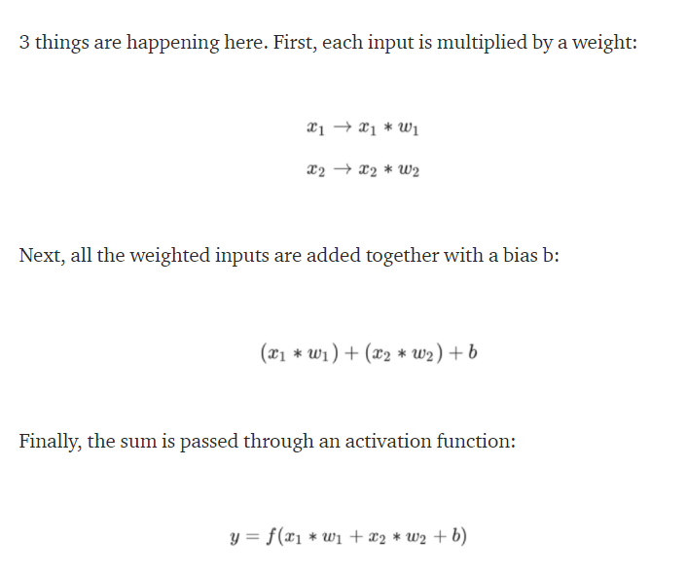
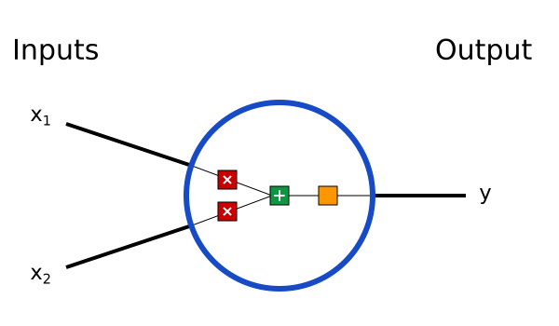
Introduction to Neural Networks
A computing system made up of a number of simple, highly interconnected processing elements, which process information by their dynamic state response to external inputs
Building Blocks: Neurons
The basic unit of a neural network. A neuron takes inputs, does some math with them, and produces one output. Here’s what a 2-input neuron looks like

Slide 12
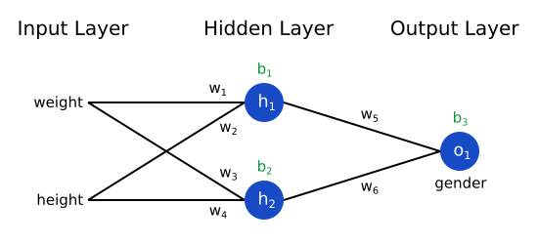
Contd..
2. Combining Neurons into a Neural Network
A neural network is nothing more than a bunch of neurons connected together. Here’s what a simple neural network might look like
This network has 2 inputs, a hidden layer with 2 neurons (h1​ and h2​), and an output layer with 1 neuron (o1​). Notice that the inputs for o1​ are the outputs from h1​ and h2​ — that’s what makes this a network.
A hidden layer is any layer between the input (first) layer and output (last) layer. There can be multiple hidden layers!

Slide 13
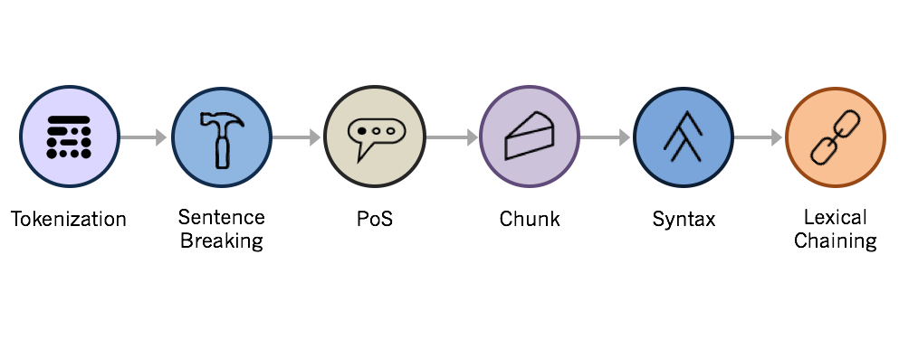
Different steps in text analysis
There are 7 basic steps involved in preparing an unstructured text document for deeper analysis:
Language Identification
Tokenization
Sentence Breaking
Part of Speech Tagging
Chunking
Syntax Parsing
Sentence Chaining

Slide 14
Tokenisation
Tokenisation is the process of breaking text documents apart into those pieces.
In text analytics, tokens are most frequently just words. A sentence of 10 words, then, would contain 10 tokens. For deeper analytics, however, it’s often useful to expand your definition of a token. For Lexalytics, tokens can be:
Words & Punctuation (exclamation points intensify sentiment)
Hyperlinks (https://…) & Possessive markers (apostrophes)
Tokenisation can be done
Tokenization using Python’s split() function
Tokenization using Regular Expressions (RegEx)
Tokenization using NLTK
Tokenization using the spaCy library
Tokenization using Keras
Tokenization using Gensim

Slide 15
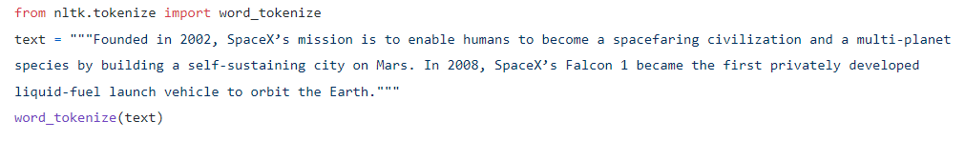
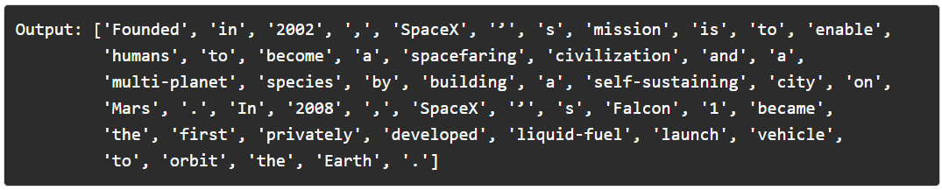
Tokenisation using NLTK(Natural Language ToolKit)
NLTK contains a module called tokenize() which further classifies into two sub-categories:
Word tokenize: We use the word_tokenize() method to split a sentence into tokens or words

Slide 16
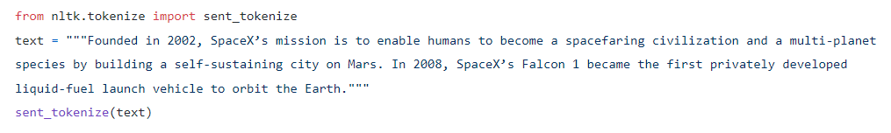
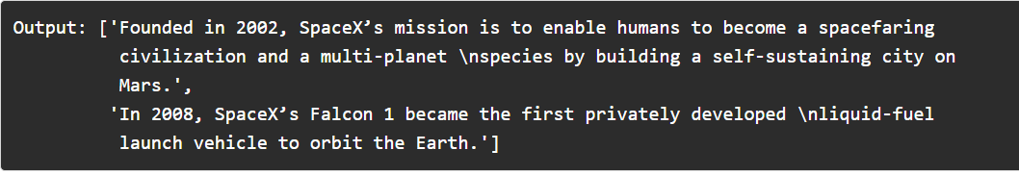
Contd..
Sentence tokenize: We use the sent_tokenize() method to split a document or paragraph into sentences

Slide 17
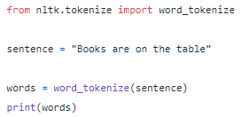


Small Practicising session
Tokenisation: Splitting the sentence into words.
Lower casing: Converting a word to lower case (NLP -> nlp).

Slide 18
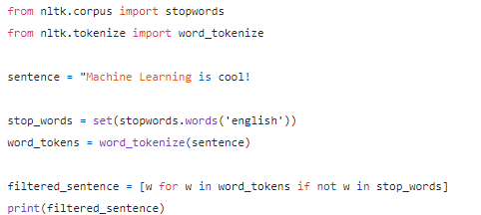

Contd..
Stop words removal: Stop words are very commonly used words (a, an, the, etc.) in the documents. These words do not really signify any importance as they do not help in distinguishing two documents

Slide 19
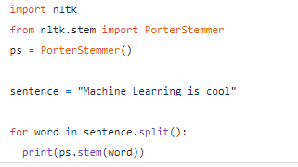
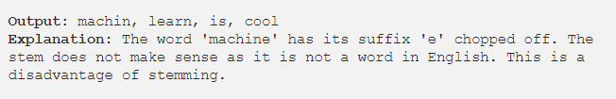
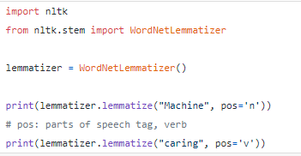

Contd..
Stemming: It is a process of transforming a word to its root form.
Lemmatization: Unlike stemming, lemmatization reduces the words to a word existing in the language. Lemmatization is preferred over Stemming because lemmatization does a morphological analysis of the words.

Slide 20
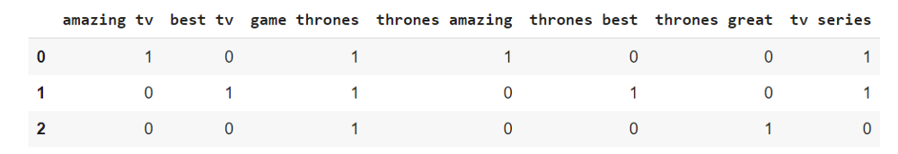
Analysing bag of counts
Analyzing the reviews about Game of Thrones:
Review 1: Game of Thrones is an amazing tv series!
Review 2: Game of Thrones is the best tv series!
Review 3: Game of Thrones is so great
Notes:
Explain about insights from simple word counts

Slide 21
Text Cleaning using Regex Patterns
Regular Expression is a text string that describes a search pattern which can be used to match or replace patterns inside a string with a minimal amount of code
Searching Patterns in a String
Match():
To search a pattern within a string, the match and findall function of the re package is used
text = "The film Titanic was released in 1998“
result = re.match(r".*", text)
The first parameter of the match function is the regex expression that you want to search. Regex expression starts with the alphabet r followed by the pattern that you want to search
result = re.match(r".+", text) To match a string with a length of at least 1
result = re.match(r"[a-zA-z]+", text)
This regex expression states that match the text string for any alphabets from small a to small z or capital A to capital Z. The plus sign specifies that string should have at least one character
Notes:
print(result.group(0)) to see the output

Slide 22
Contd..
Search()
The search function is similar to the match function i.e. it tries to match the specified pattern. However, unlike the match function, it matches the pattern globally instead of matching only the first element. Therefore, the search function will return a match even if the string doesn't contain an alphabet at the start of the string but contains an alphabet elsewhere in the string
text = "1998 was the year when the film titanic was released"
result = re.search(r"[a-zA-z]+", text)
Substituting text in a String
text = "The film Pulp Fiction was released in year 1994“
result = re.sub(r"Pulp Fiction", "Forrest Gump", text)
let's substitute all the alphabets in our string with character "X".
result = re.sub(r"[a-z]", "X", text)

Slide 23
Shorthand Character Classes
Removing Digits from a String
text = "The film Pulp Fiction was released in year 1994"
result = re.sub(r"\d", "", text
Removing Alphabet Letters from a String
text = "The film Pulp Fiction was released in year 1994"
result = re.sub(r"[a-z]", "", text, flags=re.I)
Removing Word Characters
text = "The film, '@Pulp Fiction' was ? released in % $ year 1994."
result = re.sub(r"\w","", text, flags = re.I)
Removing Non-Word Characters
text = "The film, '@Pulp Fiction' was ? released in % $ year 1994."
result = re.sub(r"\W", "", text, flags=re.I)
Notes:
r‘A*’ matches A 0 or more times (‘’, ‘A’, ‘AA’, ‘AAA’, ‘AAAA’, etc.) r‘A+’ matches A 1 or more times (‘A’, ‘AA’, ‘AAA’, ‘AAAA’, etc.) r‘[a-z]*’ matches any lowercase letter 0 or more times (‘’, ‘ajrk’, ‘bor’, ‘q’, etc.) r‘[0–9]+’ matches any number 1 or more times (‘1’, ‘254’, ‘1029345’, etc.) r‘ing$’ matches words that end with -ing (‘running’, ‘climbing’, ‘ing’, etc.) r‘^st’ matches words that start with st- (‘string’, ‘stir’, ‘strive’, etc.) r‘[^a]’ will match any string without an a (‘surprise’, ‘d4nfo.’, interesting!’, etc.) r‘.{4}’ matches any string of 4 characters without a newline (‘9?rf’, ‘(hi)’, etc.)

Slide 24
Contd
Grouping Multiple Patterns
text = "The film, '@Pulp Fiction' was ? released _ in % $ year 1994."
result = re.sub(r"[,@\'?\.$%_]", "", text, flags=re.I)
Removing Multiple Spaces
text = "The film Pulp Fiction was released in year 1994."
result = re.sub(r"\s+"," ", text, flags = re.I)
Removing Spaces from Start and End
text = " The film Pulp Fiction was released in year 1994"
result = re.sub(r"^\s+", "", text)
Removing a Single Character
text = "The film Pulp Fiction s was b released in year 1994“
result = re.sub(r"\s+[a-zA-Z]\s+", " ", text)

Slide 25
Contd
Splitting a String
text = "The film Pulp Fiction was released in year 1994 "
result = re.split(r"\s+", text)
Finding All Instances
text = "I want to buy a mobile between 200 and 400 euros“
result = re.search(r"\d+", text)
text = "I want to buy a mobile between 200 and 400 euros"
result = re.findall(r"\d+", text)

Slide 26

Ask your Questions !
Questions?

